Slide 1
An introduction to the capital markets
J.P. Morgan Investment Academy
Notes:
Good morning/afternoon. (INTRODUCE presenters).
I’d like to thank you for your time today as we explore another facet of the world of investing. Today’s presentation is an introduction to the capital markets, which, for some of you, will serve as a refresher.
We’ll review the complex structure of the markets and how institutions, governments, investors and advisors interact with one another. The topic merits a lot more time than our conversation today permits, but I hope it serves as a good overview.
But before we get started, I’d like to ask you a couple of questions:
How many of you own your own home? Would you agree that buying your first house was one of the biggest decisions you ever made?
How many of you have bought or sold shares in a stock or a mutual fund?
All these financial transactions — buying a home, or buying or selling shares of a stock or fund — occur within the confines of what we call the capital markets.

Slide 2
Interconnected, ordered chaos
Our financial system is a colossal market of buyers and sellers.
Notes:
Do any of you remember the simple, low-tech game of pick-up sticks? Once the sticks are released in random disarray on a tabletop, the goal is to remove a stick from the pile without disturbing the remaining ones. The game is over when the last stick is removed and the player with the most sticks wins.
Most kids today would think it’s kind of boring, but for me, it’s a good metaphor for the interconnectedness and ordered chaos of our constantly changing financial markets.
Throughout history, human beings have formed “markets” to sell goods and services to willing buyers. The U.S. economic system — and those of most countries throughout the world — is a colossal market encompassing many moving parts and different kinds of participants; the capital markets reside within this broad framework.

Slide 3


The U.S. economic system
Financial markets interact with many aspects of the economy.
Borrowers
Labor markets
Lenders
Financial
institutions
Federal Reserve
Agricultural markets
Savers
The U.S. economic system
Regulators
Natural resources
Exchanges
Governments
Brokers and
intermediaries
Small businesses
Investors
Notes:
From labor and agricultural markets to small businesses, large corporations, the Federal Reserve System and government — these components interact in complex ways.
It’s nearly impossible to consider one component without taking into account the way it involves many others; sort of like the game of pick-up sticks.
Take the Federal Reserve, for example. The “Fed," is our country’s central bank, and was created in 1913 to provide a safe and stable monetary and financial system. Its mission is to help foster a healthy economy — which benefits everyone: employers, employees, investors, borrowers, lenders, governments.
The Fed’s policies impact things like employment climate, interest and borrowing rates, and supervising and regulating financial institutions. So, when the Fed makes a move — raising or lowering interest rates, for example — its decisions impact the way individuals, companies and governments borrow and lend money, and influence the returns investors earn on their assets.

Slide 4
Role of capital in growing the economy
The capital markets are a virtual marketplace in which stocks and bonds are traded.
Sell stocks and bonds to investors
Capital markets
Raise capital for governments and businesses
Provide liquidity for an effective marketplace
Notes:
But we don’t have enough time today to explore the broad U.S. economic structure. In the context of our discussion, capital describes the funding needs of businesses and governments that help them grow and expand.
It is the capital markets that help raise these funds for businesses by selling investment instruments — stocks and bonds — to investors.
Capital markets refer to a virtual marketplace in which capital-raising transactions take place and where stocks and bonds are traded.
These markets also provide liquidity, enabling investors to convert assets into cash easily without disrupting the markets. This efficiency also allows corporations and government agencies to readily raise long-term capital at fair prices.
Why is that important? Because a high level of liquidity is an essential ingredient for an effective and efficient market.
You may recall that, at the beginning of the global financial crisis, a number of companies found themselves in a liquidity crisis. Investors had lost confidence in the value of certain securities, and there were fewer buyers than there were sellers. Many traders had to sell these illiquid assets at a loss.

Slide 5
The benefits of the capital markets
Capital markets meet the income needs of investors and the funding needs of businesses.
Businesses and governments
Raise needed capital
Investors
Gain income and capital appreciation
Create jobs
Meet payroll
Expand business
Provide services
Achieve financial goals
Buy home
Retire securely
Fund college
Notes:
In the U.S., the capital markets are the lifeblood of capitalism and perform two important roles that are vital to economic development.
The stock and bond markets serve as the conduit to match those who have capital with those who seek it. Those who seek capital — business and governments — use it to grow and expand, which helps create jobs and provides other benefits to the U.S. economy.
The capital markets play an important role in the lives of investors by providing a source of income and capital appreciation; when the securities appreciate in value, investors’ wealth increases.
The stock and bond markets also benefit investors by helping them achieve long-term financial goals, such as buying a home or funding retirement and education objectives.
Let’s take a closer look at each of these markets.

Slide 6
The equity markets
The stock market facilitates the exchange of securities between buyers and sellers.
Stock market
Primary
Securities are created in the primary market through an initial public offering.
Secondary
In the secondary market, investors trade previously issued securities without the involvement of the issuing companies.
Notes:
The stock market facilitates the exchange of securities between buyers and sellers. For over 200 years, people have turned to the U.S. stock market for investment purposes.
Corporations look to the stock market to raise money to help them run and grow their business.
A company’s equity securities are created in the primary market through what is known as an initial public offering, or IPO — the first sale of stock by a private company to the public. In an IPO, the company, or issuer, obtains the assistance of an underwriting firm that helps determine what type of security to issue (common or preferred), the best offering price and when to bring it to market. You may recall the hubbub when Facebook went public in May of 2012. The IPO was plagued by a series of problems when its exchange, NASDAQ, suffered a computer malfunction during the first hours of offering, leading to tens of millions of dollars in trades being wrongly placed. And its underwriter, Morgan Stanley, faced claims that the initial price was too high and that they had issued too many shares.
Once a company’s shares have been issued, investors may trade the securities among themselves in the secondary market.

Slide 7
The secondary market
On the stock market’s secondary tier, investors trade securities among themselves.
Secondary market
Auction market (such as the New York Stock Exchange)
Traders congregate together on the same floor and announce bid and ask prices.
Dealer market (such as NASDAQ)
Trades are made through an electronic network between investors and buyers or sellers who are market makers.
Notes:
The location of an exchange refers not so much to a street address but the "place" where its transactions take place.
The NYSE is an auction market — where the classic images of traders waving their hands and shouting is routine; trades occur on the trading floor in New York City through these traders.
The NASDAQ, on the other hand, is an electronic network. Trades take place directly between investors and buyers or sellers who are market makers; all the transactions are electronic.
Today there are tens of thousands of company stocks available for purchase in the U.S. alone.

Slide 8
How stocks behave
In any given year, the range of returns on stocks can be very wide.
Notes:
So how do stocks behave?
This is a slide from our quarterly Guide to the Markets publication.
This chart illustrates the range of returns in a single year going back to 1980 for all 500 stocks in the Standard & Poor’s 500 Index. Declines are depicted by the pink dot, and the full-year returns are represented by the grey bar.
In any given year, the range of stock market returns can be very wide; look at 2012, for example, the last bar on our chart. During the course of the year, stock prices moved within a 23-point range; their low point of the year was a negative 10%, but they finished the year up 13%.

Slide 9
100+ years of stock market investing
Stocks may be unpredictable in the short term, but have a definite pattern in the long term.
Notes:
In this chart, also from the Guide, we illustrate the long-term performance of the Dow Jones Industrial Average — from 1900 through 2012.
So, while stocks may be volatile and unpredictable over the short term, like the wide range of returns we saw on the previous slide, there generally is a pattern to how they behave over the long term.

Slide 10
The bond markets
The broader bond market is classified into five specific bond markets.
Corporate
Government and agency
Municipal
Mortgage-backed, asset-backed and collateralized debt obligation
Funding
The bond markets
Notes:
Now let’s turn our attention to the bond markets — the largest capital markets in the world. When you buy bonds, you are lending money to a corporation or the government in exchange for their promise to pay you back all your money — with interest, of course. Put another way, a bond is an IOU.
As we just learned with the stock market, the bond markets also have primary and secondary markets that afford investors access to bonds. Bonds are originally issued to the public through the primary market, with an investment bank acting as the intermediary. Most of the time, bond sales in the primary market occur between investment banks and institutional investors.
The trading of already-issued bonds takes place in the secondary market. It’s important to note that a bond’s price is established in the primary market and investors pay the face value of the bond. In the secondary market though, bonds rarely sell at par value. Investors have to be able to effectively value bonds they are buying or selling, which requires a fair amount of skill and knowledge.
Generally, the bond markets encompass five major categories:
Government and agency bonds – the largest category, followed by:
Corporate
Municipal
Mortgage-backed, asset-backed and collateralized debt obligations
Funding
Investors who don't like the risk and variability of the stock market, especially retirees, are attracted to bonds. Unfortunately, bonds are not only complex, they can be risky as well.

Slide 11
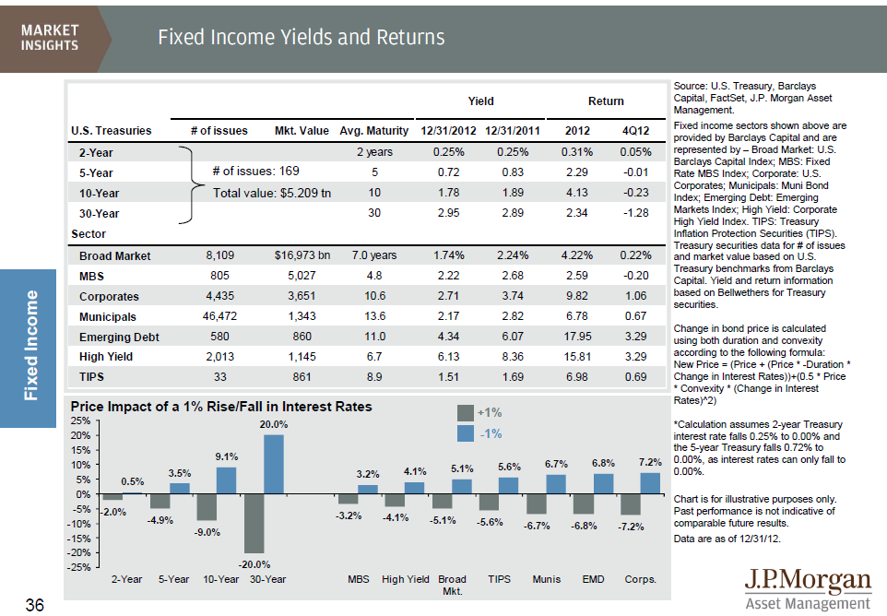
Bond yields and returns
Changes in interest rates will impact the value of a bond.
Notes:
This is another slide from our Guide to the Markets quarterly publication. It shows the current bond yields and returns of various bond sectors, and illustrates the relationship of interest rates to these returns.
When prevailing interest rates change — even just one basis point (–0.01%) — the current value of a bond will reflect that change.
An investor who intends to hold an individual bond to maturity can ignore all price changes that would affect selling the bond on the secondary market. Barring default, the investor will receive the face value at maturity.
But mutual fund managers — and investors in those funds — know that several factors determine a bond’s value; its price can be very volatile when interest rates change. Its true value is a function of a combination of factors:
Par value: the original price per bond, typically $1,000
Coupon: the stated annual interest rate to be paid to the bondholder
Years to maturity: the number of years left until maturity
Credit rating: the third-party rating indicating the likelihood that interest and principal will be paid on time
Prevailing level of market interest rate: the current interest rate offered on a similar bond

Slide 12
Primary reasons for buying bonds
Historically, bond prices have been more stable than stocks.
To preserve capital
To generate a predictable income stream
To diversify portfolio holdings
To take advantage of unique opportunities
Notes:
The primary reasons investors buy bonds.
To preserve capital
To generate a predictable income stream, and in the case of municipal bonds, income that has favorable tax consequences
To diversify overall portfolio holdings — conservative investors tend to own a larger proportion of fixed income securities
To take advantage of unique opportunities in certain fixed income sectors both domestically and abroad
The interest bonds pay can be fixed (the same amount every pay period) or it can be floating or even payable at maturity. Most debt securities carry an interest rate that stays fixed until maturity and is a percentage of the face (principal) amount. Typically, investors receive interest payments semi-annually.
For example, a $1,000 bond with an 8% interest rate will pay investors $80 a year, in payments of $40 every six months. When the bond matures, investors receive the full face amount of the bond: $1,000.
In a portfolio setting, bonds are considered less risky than stocks because historically bond prices have been more stable, and the bond issuers — or borrowers — promise to repay the debt to bondholders at maturity. That promise is generally kept unless the issuer falls on hard times.

Slide 13
How the fixed income sector behaves
Each sector of the bond market responds uniquely to market dynamics.
Notes:
Each sector of the bond market responds uniquely to market dynamics.
This chart from our Guide to the Markets really helps illustrate that. For example, the U.S. Treasury market, represented here by the purple color, is considered a core building block. But as interest rates have fallen, investors have sought higher income in other market sectors, particularly in the high yield and emerging market debt markets where returns have been very lofty over the past couple of years.

Slide 14
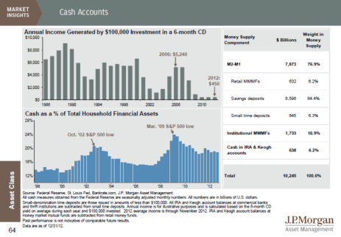
U.S. Treasury yields at historic lows
Low interest rates have decreased investor income, thereby impairing cash flow.
Notes:
If we consider the current market, you can get a sense for the challenge income investors face today.
The Fed has kept rates very low to stimulate the economy, resulting in historically low yields on cash instruments and traditional fixed income.
If you’re a business looking to the capital markets for funding, a low-interest rate environment is ideal; if you’re an investor, though, it makes for a less than desirable return. For example, just five years ago, the annual income generated by a $100,000 six-month CD was roughly $5,000, whereas today it is a small fraction of that, and well lower than the inflation rate.
Furthermore, if interest rates ultimately rise, as widely expected, bond holders can get hurt.

Slide 15
Capital markets regulation
The Securities and Exchange Commission (SEC) is the primary securities regulator at the federal level.
Securities exchanges
Brokers/ dealers
Investment advisors
Mutual funds
SEC oversees key participants in the securities world
SEC oversees key participants in the securities world
Notes:
One could argue that the capital markets in the United States are successful because they are so well regulated. That hasn’t always been the case in our country — or others for that matter; it’s definitely a subject worthy of further discussion.
At the federal level, the SEC is the primary regulator; its mission is to protect investors; maintain fair, orderly, and efficient markets; and facilitate capital formation. It oversees the key participants in the securities world, including securities exchanges, securities brokers and dealers, investment advisors, and mutual funds. Here, the SEC is concerned primarily with promoting the disclosure of important market-related information, maintaining fair dealing, and protecting against fraud.
As you know, there are many other regulators — at the federal and state levels — with different jurisdictions that oversee insurance companies, banks, savings and loans, credit unions, brokerage firms, etc.
The alphabet soup of regulators includes the Office of the Comptroller of the Currency, the Federal Reserve, the Federal Deposit Insurance Corporation, National Credit Union Administration, Commodities Futures Trading Commission, Financial Industry Regulatory Authority (FINRA), along with state insurance and securities regulators.

Slide 16
Getting the most from the capital markets
Being diversified can help reduce volatility and increase long-term returns.
Notes:
Finally, I think it’s only fitting to conclude our discussion about the capital markets with one last slide from our Guide to the Markets publication.
As we’ve discussed today, the capital markets afford access to a large — and growing — number of investment choices, all of which help fund growth and expansion of the global economy.
From an investment perspective, the most effective way to get the most from the world’s capital markets is to own a diversified blend of assets: To achieve meaningful diversification, investors should invest across traditional and alternative asset classes, incorporate developed and emerging markets equity, fixed income and currency exposure to their overall long-term portfolios.
This multi-colored chart demonstrates that because asset classes don’t move in lockstep, being appropriately diversified across a broader opportunity set can help reduce volatility and increase long-term returns. Here, we’ve tracked the performance of the “asset allocation” portfolio in this chart. This hypothetical portfolio would have returned 74% over the past 10 years, while the S&P 500 returned only 33% over the same period.

Slide 17
Disclosure
The above commentary is intended solely to report on various investment views held by J.P. Morgan Asset Management. Opinions and estimates offered constitute our judgment and are subject to change without notice, as are statements of financial market trends, which are based on current market conditions. We believe the information provided here is reliable, but do not warrant its accuracy or completeness. This material is not intended as an offer or solicitation for the purchase or sale of any financial instrument. The views and strategies described may not be suitable for all investors. This material has been prepared for informational purposes only and is not intended to provide, and should not be relied on for, accounting, legal or tax advice. References to future returns are not promises or even estimates of actual returns a client portfolio may achieve. Any forecasts contained herein are for illustrative purposes only and are not to be relied upon as advice or interpreted as a recommendation.
J.P. Morgan Asset Management is the marketing name for the asset management businesses of JPMorgan Chase & Co. Those businesses include, but are not limited to, J.P. Morgan Investment Management Inc., Security Capital Research & Management Incorporated and J.P. Morgan Alternative Asset Management, Inc.
© J.P. Morgan Chase & Co., April 2013

Slide 18
声明：
所有的版权属于原有公司，文件均来自公开渠道
此文件仅供学习使用，任何人不得进行以此为商业目的的行为
如有疑问，请立即删除
学习世界五百强和咨询公司PPT课程请访问如下网站搜索：“司马懿”
百度传课：司马懿PPT学校
https://www.chuanke.com
网易学堂：司马懿PPT学校
https://study.163.com
知乎： 司马懿PPT学校
https://www.zhiu.com

